Slide 1

Chuhan Jin, Elena Sharp, Vianka Barboza, Chris Asmussen, Alann Jurado, Yichen Duan

Slide 2
Overview
Main users: College student who primarily rents or sells their textbooks online, and are looking for the lowest prices for all of their class materials.
EDUEXCHANGE can be used by anyone who has the URL and has a .edu email
Pass-through selling service
Meet people on campus
All cash/venmo/checks

Slide 3
Back End
We created our database to have 4 tables
(user, textbooks, notes, and supplies)
We use .sql files to make and fill our databases
Provides reliability as well as safety
25 users auto-created and 25 listings per other tables
We use a standard lamp stack & slim
We use Php md5(), mail(), session

Slide 4
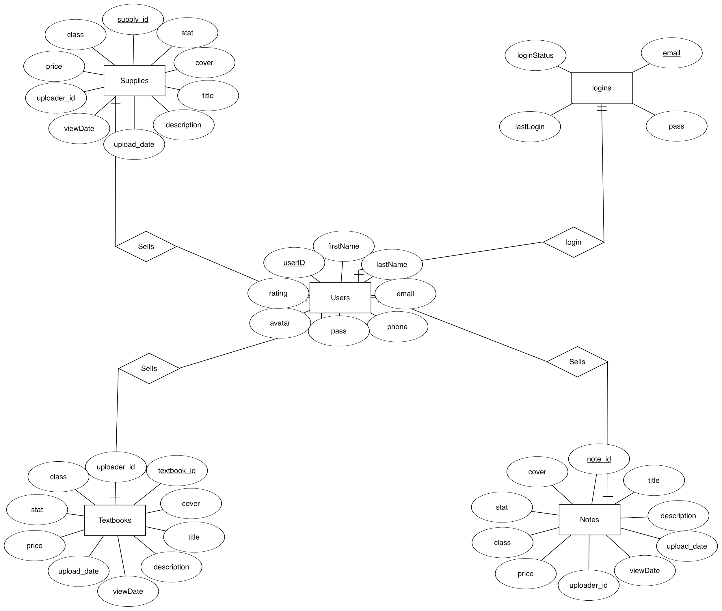

Slide 5
Front End Technologies
Angular 2
One of the more popular and documented frameworks
Better performance, and includes filters
Separates functionality
Angular-cli
Built for production
Makes importing to server cleaner

Slide 6
DEMO

Slide 7
Conclusion
We aimed to make a pass through selling service to convenience students when buying textbooks, supplies, and other goods
As a group, we consider our work so far to be a success

Slide 8
Q&A

